Slide 1
A BRIEF PRESENTATION ON
Stock Market App
by:
Abhinav Thalishetti

Slide 2
PROBLEM STATEMENT
Create a website that shows different types of graphs based on stock prices and hovering over data points should reveal additional information.

Slide 3
ABSTRACT
Simple stock market web application made using react.js and Twelve Data API. It shows various kinds of graphs, visualized based on the opening price and closing prices as data points, of different kinds of stocks.

Slide 4
WORKING PRINCIPLE
StockMarketData react component is the main component that works in the background.
It fetches data using ‘axios’ from Twelve Data API and saves the acquired data.
The acquired data is then converted accordingly as data points which can be plotted on a graph.
The data points are passed to different kind of graph components from react-chartjs-2.
Those components along with other features, are then passed to the App.js.
All the components are then rendered in the index page.

Slide 5
FEATURES
Different types of stocks can be selected as input: AAPL, AMZN, ETH/BTC and EUR/USD.
Different duration periods can be given as input: 1 Day, 1 Week and 1 Month.
Different kinds of graphs can viewed: Line Chart, Bar Chart, Scatter Chart and Area Chart.
Start date and end date can also be given as input for specific time period.
Hovering over data points reveals additional information.

Slide 6
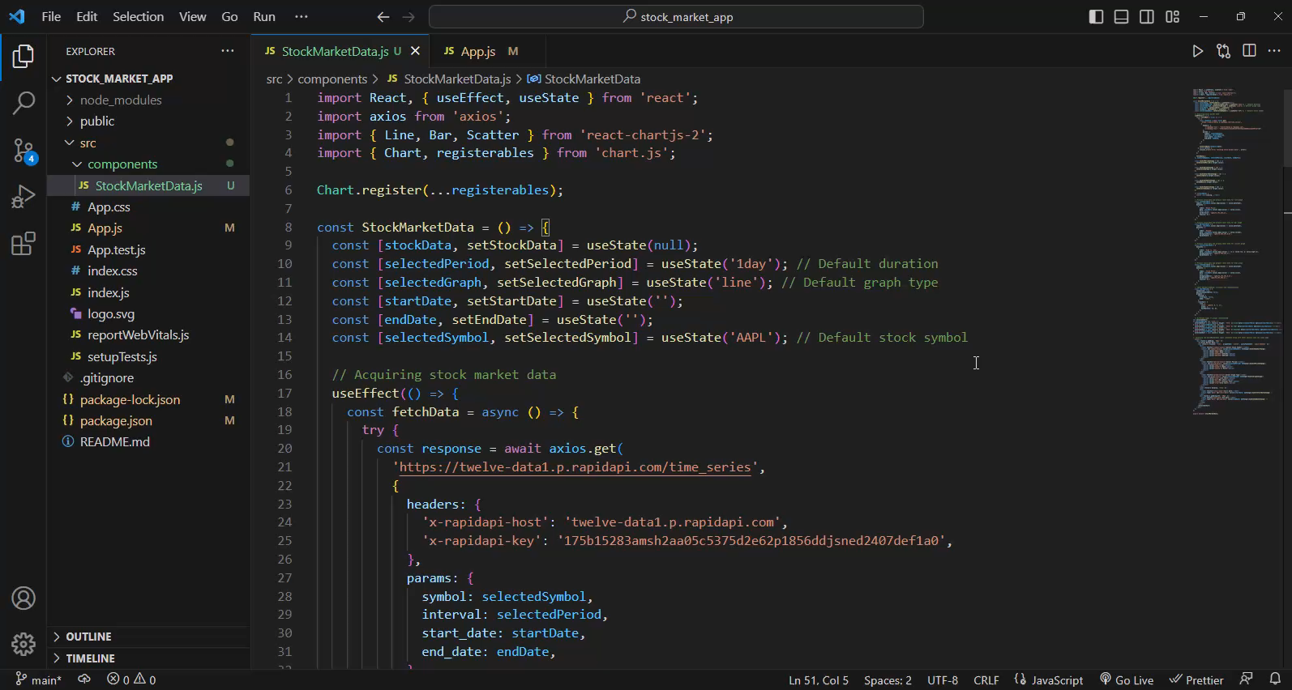
IMPLEMENTATION

Slide 7
Software used
Node.js (link : https://nodejs.org/en/download)
React.js (link : https://react.dev/learn/installation)
Twelve Data API (link : https://rapidapi.com/twelvedata/api/twelve-data1/)

Slide 8
Libraries used
axios (link : https://www.npmjs.com/package/axios)
react-chartjs-2 (link : https://www.npmjs.com/package/react-chartjs-2)
chart.js (link : https://www.npmjs.com/package/chart.js)
serve (link : https://www.npmjs.com/package/serve)

Slide 9
How to run?
Install node.js from the given link.
Open terminal, run command ‘npm install –g serve’.
Now, go to stock_market_app where ‘build’ folder is present, in the terminal.
Run command ‘serve –s build’.
Now, go to the address displayed in the terminal from your browser.

Slide 10
ANY QUERIES ?

Slide 11
~~Thank You~~

